Slide 1
SMART DUSTBIN FOR SMART CITY
INTRODUCTION TO INTELLIGENT SYSTEMS

Slide 2
INTRODUCTION
Dustbins are small plastic containers that are used to store waste on a temporary basis. They are often used in homes, offices, streets, parks etc. to collect the waste.
Usually, it is a common practice to use separate bins for collecting wet or dry, recyclable or non-recyclable waste.
In this project, we have designed a simple system called Smart Dustbin using Arduino, Ultrasonic Sensor and Servo Motor, where the lid of the dustbin will automatically open itself upon detection of human hand.

Slide 3
COMPONENTS REQUIRED
Arduino UNO
Ultrasonic Sensor Module
Servo Motor
Connecting Wires
Power Supply
A small dustbin with hinged lid
Miscellaneous (glue, cardboard, thread, etc.)

Slide 4
Arduino UNO: The Arduino Uno is a microcontroller board based on the ATmega328 (datasheet). It has 14 digital input/output pins (of which 6 can be used as PWM outputs), 6 analog inputs, a 16 MHz ceramic resonator, a USB connection, a power jack, an ICSP header, and a reset button.
Ultrasonic Sensor: An ultrasonic sensor is a device that uses sound waves to detect the presence and proximity of objects. It sends out high-frequency sound waves that bounce off objects and then measures the time it takes for the sound waves to return.
Servo Motor: The function of the servo motor is to receive a control signal that represents a desired output position of the servo shaft and apply power to its DC motor until its shaft turns to that position.

Slide 5
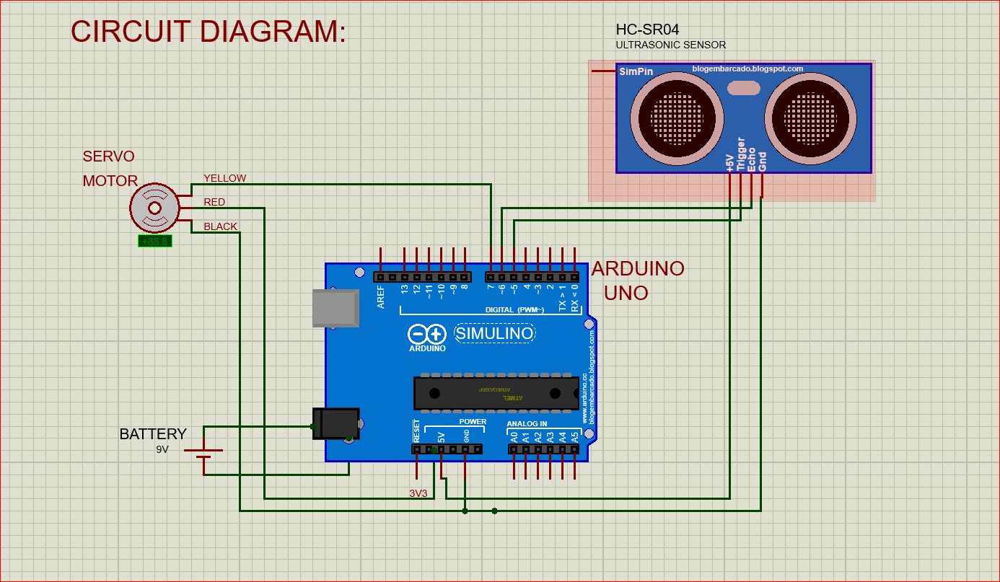
CIRCUIT DIAGRAM

Slide 6
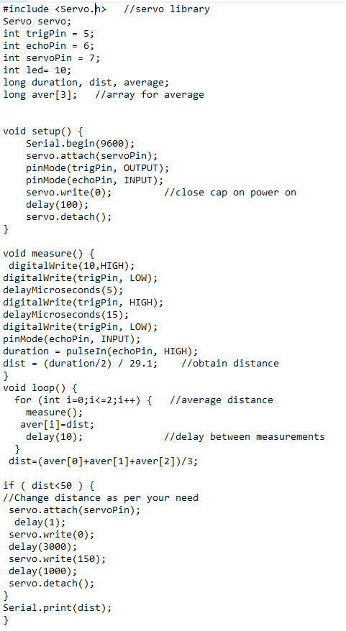
CODE AND PIN DIAGRAM

Slide 7
WORKING
After setting up the Smart Dustbin and making all the necessary connections, upload the code to Arduino and provide power supply to the circuit.
Once the system is powered ON, Arduino keeps monitoring for any object near the Ultrasonic Sensor.
If the Ultrasonic Sensor detects any object like a hand for example, Arduino calculates its distance.
And if it less than a certain predefined value, Arduino will activate the Servo Motor and with the support of the extended arm, it will list the lid open.
After certain time, the lid is automatically closed.

Slide 8
CONCLUSION
A simple but useful project called Smart Dustbin using Arduino is designed and developed here.
Using this project, the lid of the dustbin stays closed, so that waste is not exposed (to avoid flies and mosquitos) and when you want dispose any waste, it will automatically open the lid.

Slide 9
GROUP MEMBERS
RAGHAV NIMBALKAR (20210802036)
ISHIKA SINGH (20210802063)
ISHITA JOHRI (20210802085)
BHAVYA HINGAD (20210802116)
KHUSHI MUNDHADA (20210802176)

